Slide 1
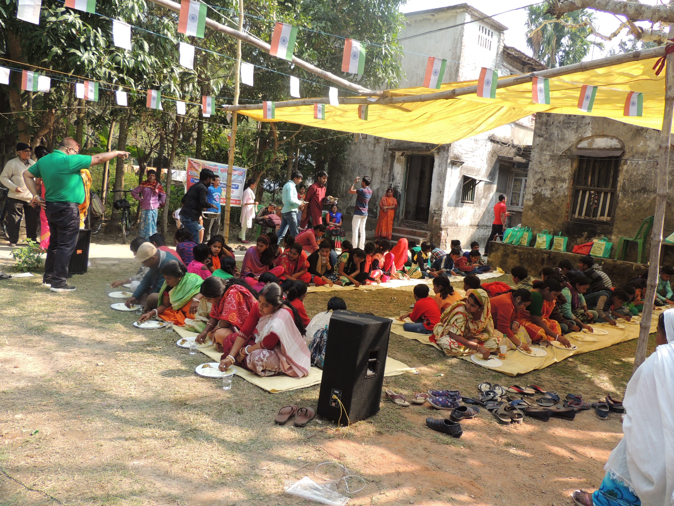
Book
Distribution
2019
Be the change to bring the change.

Slide 2
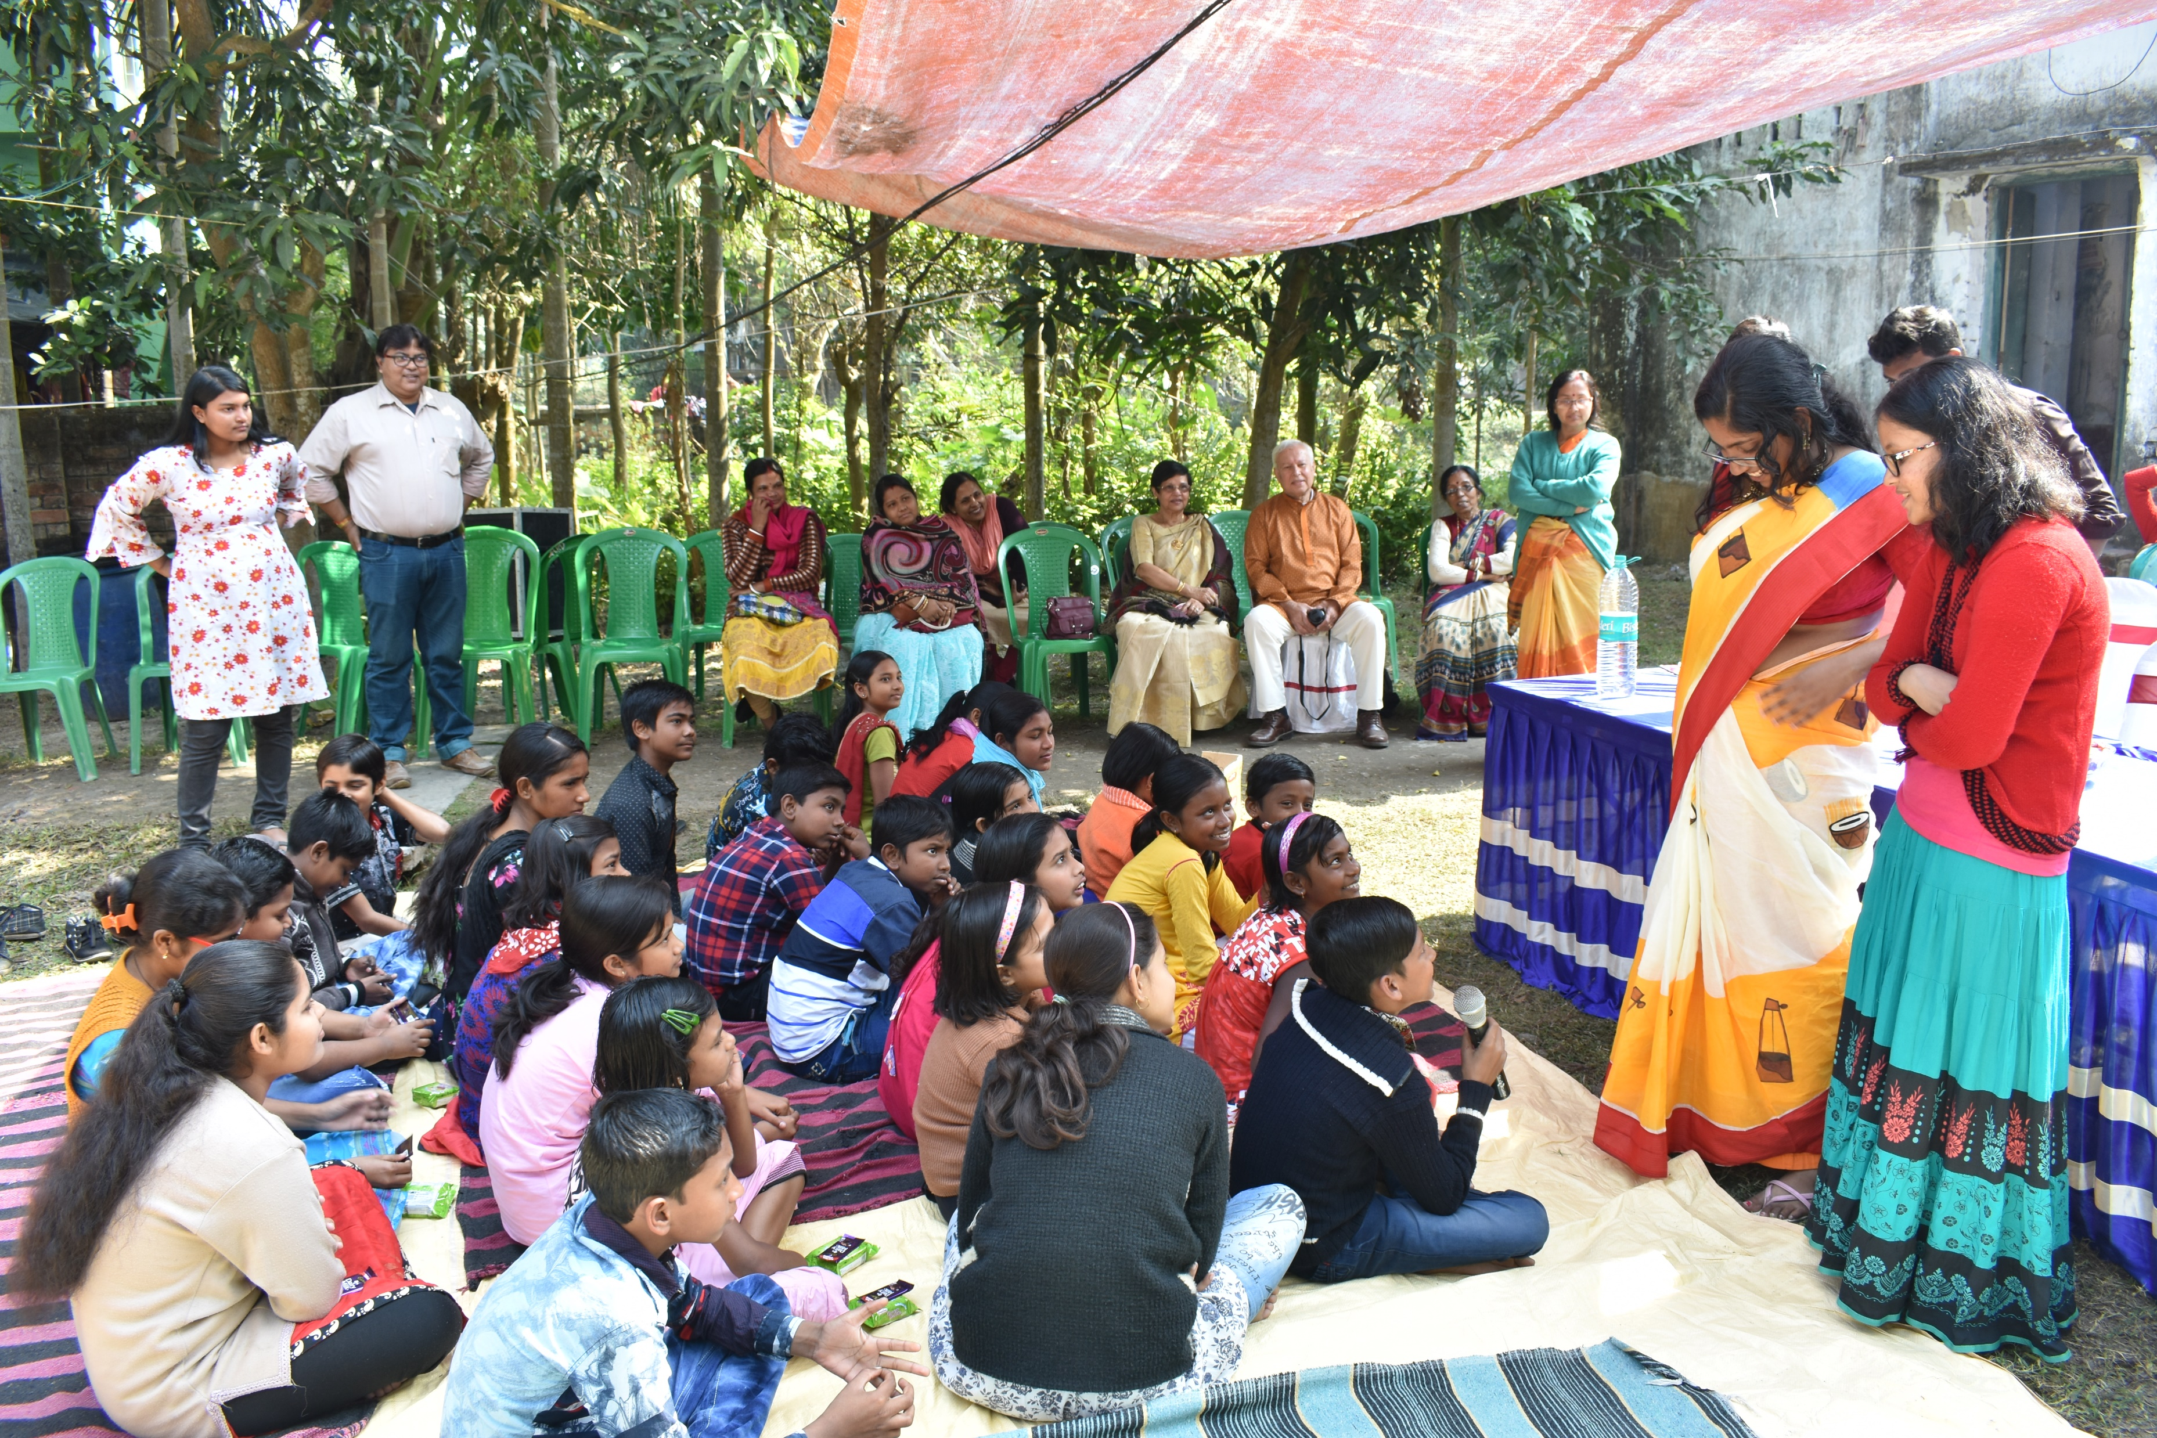
Book
Distribution
2020
Be the change to bring the change.

